Slide 1
Classification:

Slide 2
Classification comes under supervised learning. Output variable of a classification problem, is a label or a category.
For example, an email can be a spam or not a spam. An animal can be of a dog or cat.
Classification can be done in multiple categories too. A vehicle can be a train, a bus, a car of a bike. We will train certain machine learning algorithms with input and output labels and predict class for newly provided input. Let us go through these algorithms one by one.

Slide 3
Logistic Regression classification
K Nearest Neighbors classification.
Support Vector Machines
Naive Bayes classification.
Decision Tree Classification.
Random Forest Classification.
Confusion Matrix.

Slide 4
Logistic Regression Classification
Logistic Regression classification can predict results from observation and classify appropriately.

Slide 5
Problem Statement:
Consider we have data set of users of a social networking site with userId, gender, age, salary. We are a car manufacturing company and have launched a great car. We want to know whether users will buy our car or not.
Dataset:
We have some data from observations as below. It has user id, gender, age and salary of a person and whether he has purchased the car or not.

Slide 6
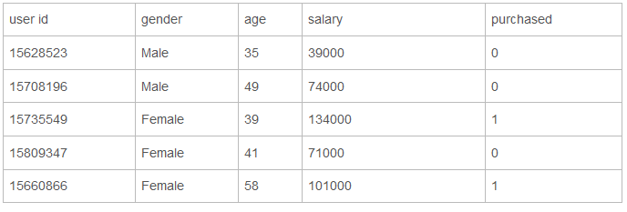

Slide 7
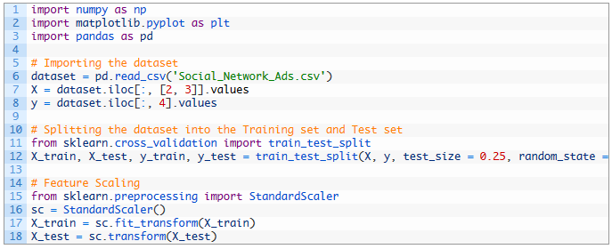
Data Processing

Slide 8
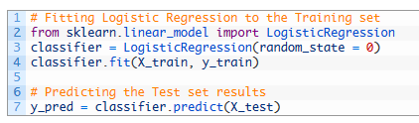
Logistic Regression:

Slide 9
We imported LogisticRegression class from sklearn.linear library.
Created classifier as object of LogisticRegression.
Fitted training data into classifier.
Predicted results for X_test and stored in y_pred

Slide 10
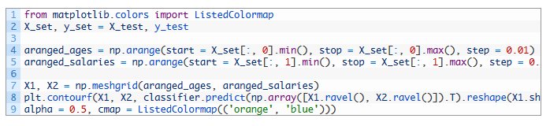
Plotting the graph:

Slide 11
I know that is lot of code for plotting a graph but I will try to explain what is being done here.
aranged_ages variable will have scaled ages of users starting from minimum age to maximum age incremented by 0.01.
aranged_salaries variable will have scaled salaries of users starting from minimum salary to maximum salary incremented by 0.01.
np.meshgrid() takes aranged_ages and aranged_salaries to form X1 and X2.
X1 and X2 are used for creating a graph which classifies all data points using logistic regression classification. It is done using plt.contourf(), method.

Slide 12
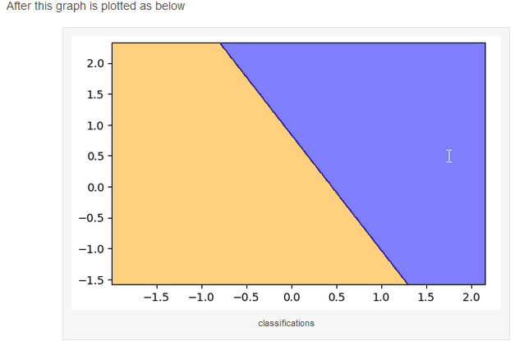

Slide 13
Note the orange and blue sections in graph.
Logistic Regression classification has classified all data points into two classes, one who will not buy the car and the one who buys it.
Orange section denotes all users who will not buy the car
Blue section denotes all users who will buy the car.

Slide 14
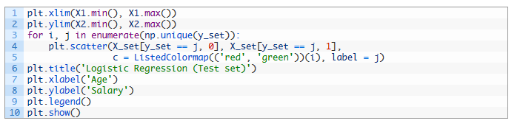
Now, these are predictions of logistic regression classification. Let us plot actual observations on this graph and we will compare results.

Slide 15
These lines will plot actual data points.
Red points denote users who did not buy the car
Green points denote users who bought the car.

Slide 16
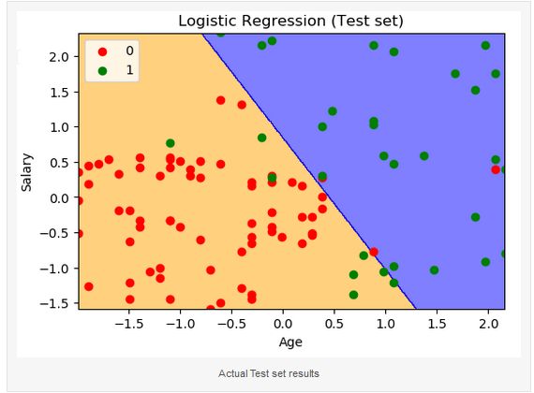

Slide 17
Note that we have plotted 100 observations from our test set and out of them
Only 8 green points are observed on orange area
Only 3 red points are observed in blue area
This means, out of 100 observation points, logistic regression classification predicted 89 results correctly and only 11 are incorrect.

